Slide 1

The Software Services
Yours !
Veera Raghava

Slide 2
The Software Services
Welcome
to Data Science Tutorials

Slide 3

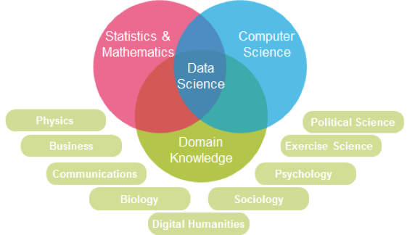
What is Data Science ?
“Data science is a science of extracting insights from the Data by making use of Statistics, Computer Science and Domain Specific Knowledge.”
Data Science is a multi-diciplinary field. it employs scientific techniques and theories drawn from many fields within the context of machine learning algorithms, mathematics, statistics, computer sciences, databases and business domains.
The Software Services

Slide 4
Why Data Science ?
Today, Data Science is becoming backbone and plays vital role behind every managerial business decisions by top level CEO’s.
Data Science acts as a well wisher to people by scientifically exploring
History of Facts and Figures, Future Predictions, Forecasting and Recommendations.
Applications of Data Science :-
E-Commerce Field :
Product Recommendations
Analyzing Customer Reviews
Customer Segmentation etc
Banking Field :
Fraud Detection
Credit Risk Detection etc
The Software Services

Slide 5
Why Data Science ?
Applications of Data Science :-
Scientific Field :
Image (Face) Recognition
Speech Recognition
Signal Detection
Anamoly Detection
Clusterring
Pattern Detection etc
Medical Field :
Disease Diagnosis
Image(X-ray,MRI,CT) Analysis
Drug Recommenditions etc
Transport Field :
Self Driven Cars
Route Recommendations
Road conditions
Speed Sugesstions
Airline Route Planning etc
IT Field :
Website Recommendations
Video Recommenditions on
Youtube,Netflix,Amazon Prime Video etc
Social Networking
Text Analytics & Emotion Detection etc
Meteorological Field :
Weather Prediction etc
The Software Services

Slide 6
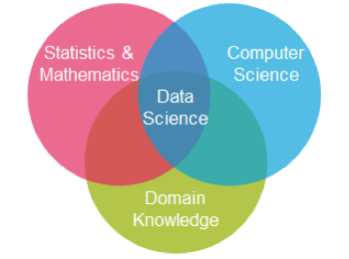
Essentials of Data Science ?
Linear Algebra
Calculus
Statistics
Probability
Python or R
SQL
Domain Expertise
The Software Services

Slide 7
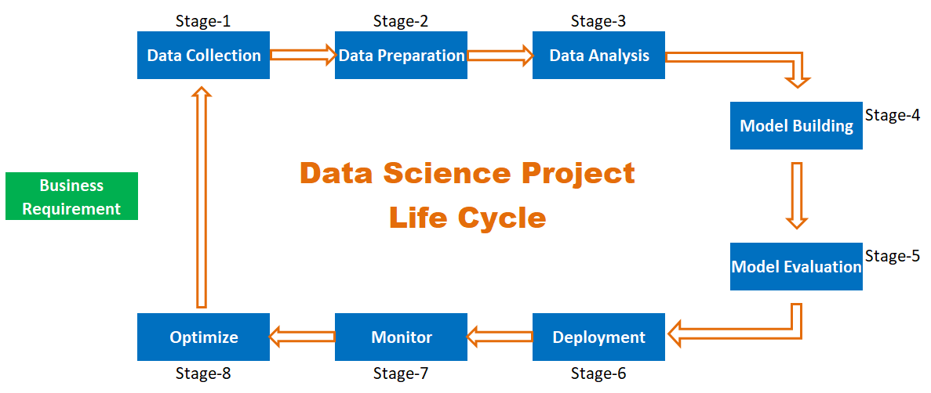
Data Science Life Cycle ?
The Data Science Project Life Cycle consists of different stages from its
inception to completion.
The Software Services

Slide 8







Its like Cooking …
Cooking
Veg. Collection
Veg. Cleaning
Veg. Selection
Taste Check
Feedback
Serving
The Software Services

Slide 9
1. Data Collection
Once you understand the requirement next step is to acquire proper relavent data that satisfies our requirement. This is done usually using ETL and the most popular tool is SQL. Data Engineers play major role in this stage.
We can acquire data from various sources like Databases, Log Files, Web Scraping, Excel files, Social Networking API’s etc…
We need to carefully choose proper data, because Data Quality is important.
Tools to Use :
SQL,
Pandas,
MS Excel etc…
pd.read_excel( )
pd.read_html( )
pd.read_json( )
pd.read_sql( )
pd.read_csv( ) etc
The Software Services

Slide 10
2. Data Preparation
The collected Data will have the consistency problems like missing data, duplicated data, spelling mistakes, improper format etc, we need to clean the collected Data and make data proper for further analysis.
Data Preparation Stage alone will take approx 80% of project time.
Better the Data Quality, Better will be the Model.
Tools to Use :
Pandas,
MS Excel etc…
df.head( )
df.tail()
df.shape
df.info( )
df.columns
df.describe( )
df.isnull( )
df.fillna( )
df.dropna( )
df.replace( )
df.drop_duplicates etc
The Software Services

Slide 11
3. Data Analysis
After preparing the required data properly in all respects we need to analyse the data and their relationships with each other.
We will analyse the data with the help of Data Visualization Plots,Graphs and Diagrams.
The aim of Data Analysis is to select proper data and proper Model to build, which satisfies our requirement.
Tools to Use :
Matplotlib
Pandas
Seaborn etc…
sns.regplot
sns.lmplot
sns.lineplot
sns.scatterplot
sns.jointplot
sns.pairplot
sns.boxplot
sns.barplot
sns.pointplot
sns.heatmap etc
The Software Services

Slide 12
4. Model Building
After analysing the data and their relationships we need to select proper Model for Model Building.
Model Building means training the appropriate Model by feeding the Data and then let the Model learns from feeded data and then Model will predict the outcome without explicit programming by programmer.
This is the stage where all Machine Learning Algorithm Models, Mathematics, Satistics comes into picture and this is where the magic begins to happen…
In order to build Models, we need the knowledge of different Machine Learning Algorithms and their underlying Mechanisms.
Tools to Use :
Sci-Kit Learn
Mathematics etc
Linear Regression
Logistic Regression
KNN
Decision Tree
Random Forest
Naïve Bayes
K-Means Clustering
Neural Networks
Deep Learning
NLP etc
The Software Services

Slide 13
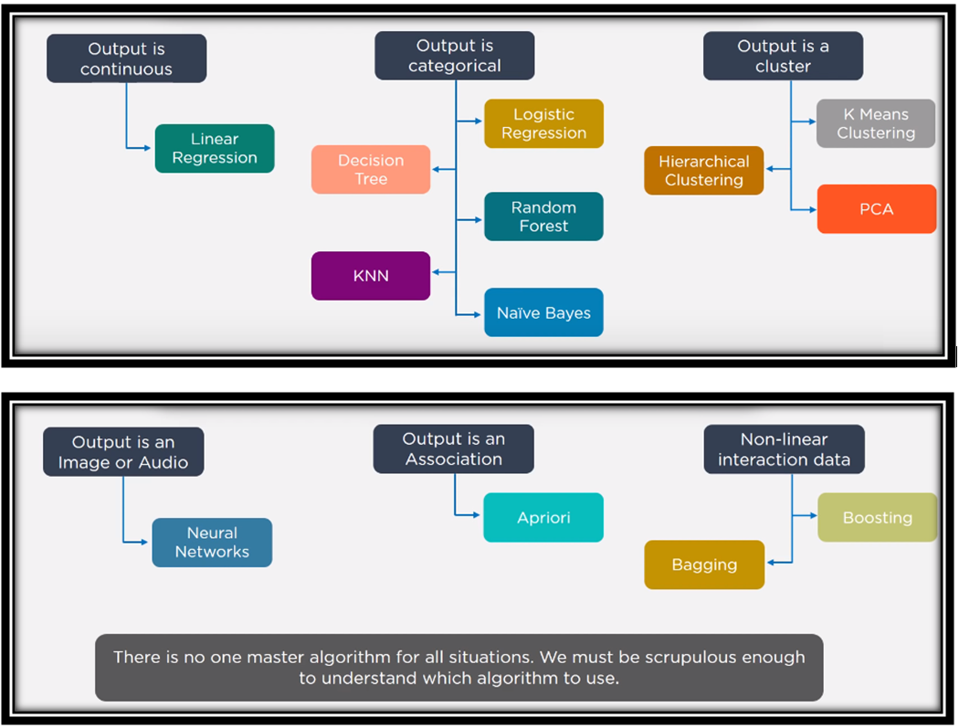
Machine Learning Alg :
The Software Services

Slide 14
5. Model Evaluation
After building the model , the performance of the model must be evaluated.
In this stage, the model performance will be tested and accuracy of the predictions will be explored.
Which Evaluation Technique should we use will depend upon the type of builded Model.
If the Accuracy of evaluated model is poor then we need to re-train the model by making essential changes in data or change the algorithm.
Tools to Use :
Sci-Kit Learn
MAE
MSE
RMSE
R-Squared Error
Confusion Matrix
Classification Report
Accuracy Score
Precision
Recall
F1 Score
The Software Services

Slide 15
6. Deployment
After modelling, once you get your initial results we should communicate the results very clearly and simply with our presentation and story telling skills.
to all the stakeholders.
Once we communicate the results and after getting all the needed approvals we can go ahead and deploy our model.
Deploying a Model will depend on which platform we wanted to deploy, whether to deploy and integrate into a Web Site or deploy on to the Cloud or in some other way.
DevOps and Software Engineers will play major role in deploying the model on required platforms.
Tools to Use :
Deployment Tools
AWS code deploy
IBM Watson
IBM Cloud
AWS Cloud
MS Azure
Docker
Jenkins
Proprietary Web Servers etc
The Software Services

Slide 16
7. Monitor
After successful deploying of Model on required platform, we need to constantly monitor the performance of the deployed model for its accuracy and other measures.
If the Model is not performing well and if its accuracy is poor then we need to optimize the model.
The Software Services

Slide 17
8. Optimize
If the Model is not performing well and if its accuracy is poor then we need to optimize the model.
In order to optimize the model, we need to cop up with the latest data trend changes and again start our steps to collect the new data, prepare data, analyse the data and re-train the model, re-evaluate the model and re-deploy the model.
The Optimization is a continuous process and it goes on and on…….
The Software Services

Slide 18
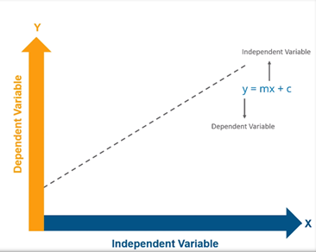

L
Linear Regression :
The Software Services

Slide 19
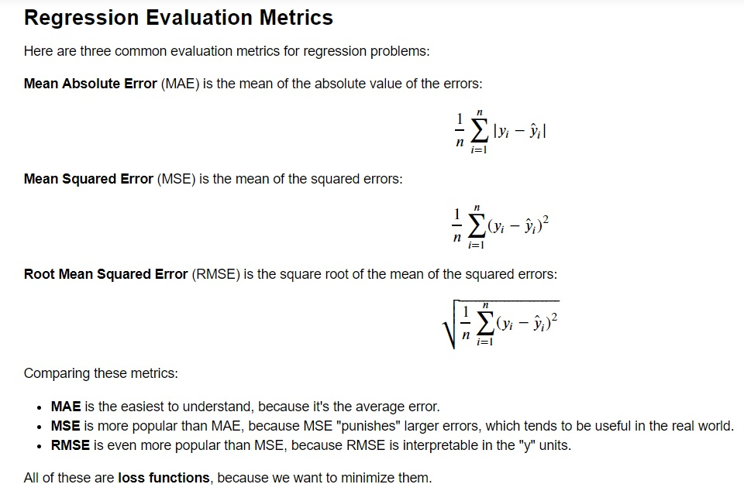
Model Evaluation :
The Software Services

Slide 20

The Software Services

Slide 21
The Software Services

Slide 22
The Software Services

Slide 23
The Software Services

Slide 24
The Software Services

Slide 25
The Software Services

Slide 26
The Software Services

Slide 27
The Software Services

Slide 28
The Software Services

Slide 29
The Software Services

Slide 30
The Software Services

Slide 31
The Software Services

